Slide 1



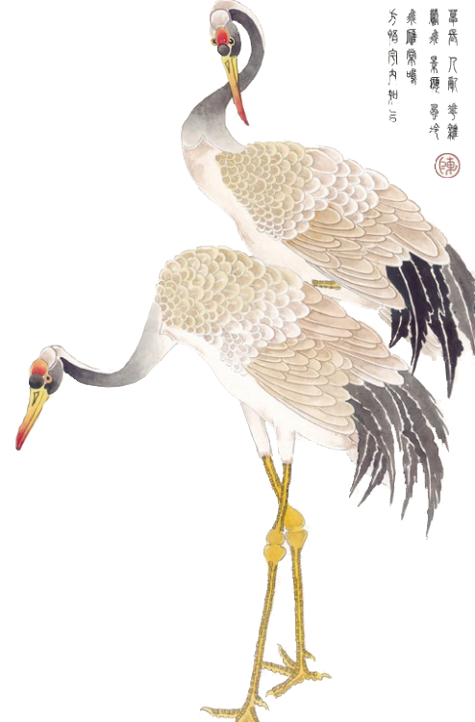
The Elegance and Revival of Hanfu:
A Journey Through Time

Slide 2


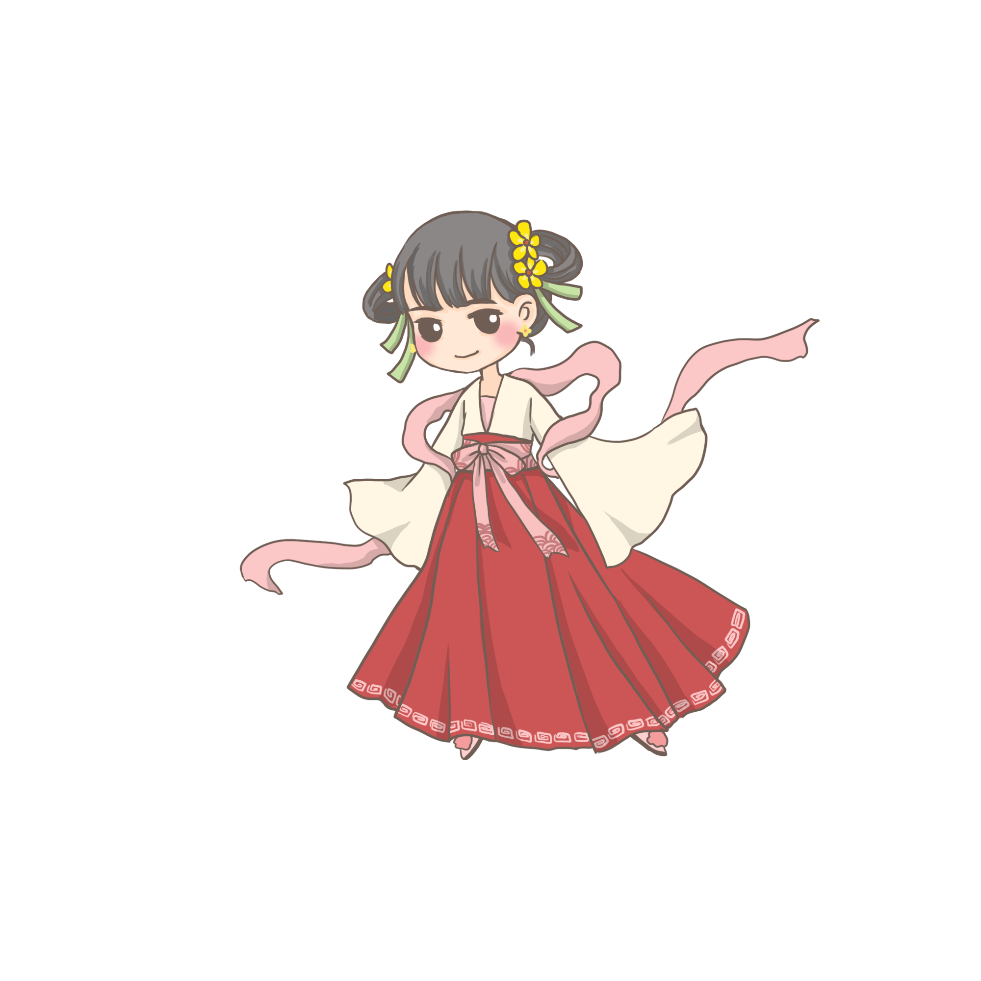


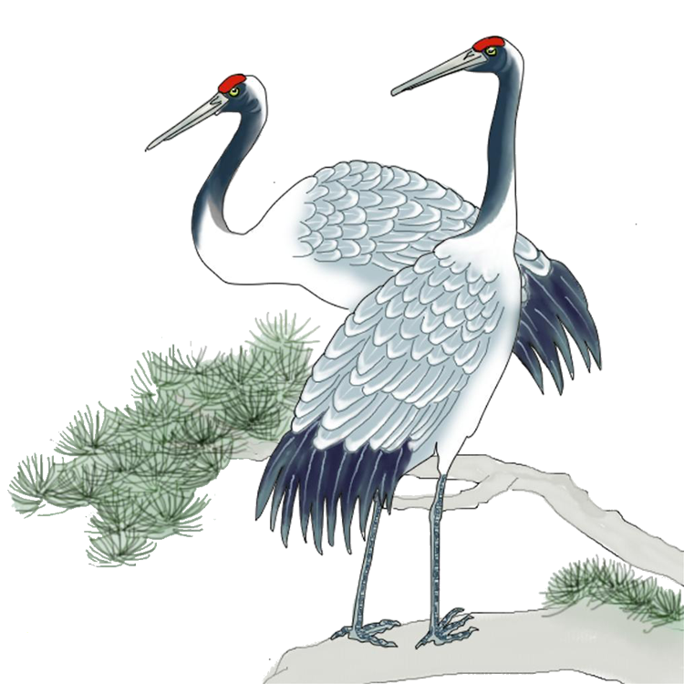
Directory
Hanfu cultrue,
origins and significance of Hanfu,
recent revival of Hanfu
Challenges of Hanfu,

Slide 3
Total
Hanfu cultrue

Slide 4

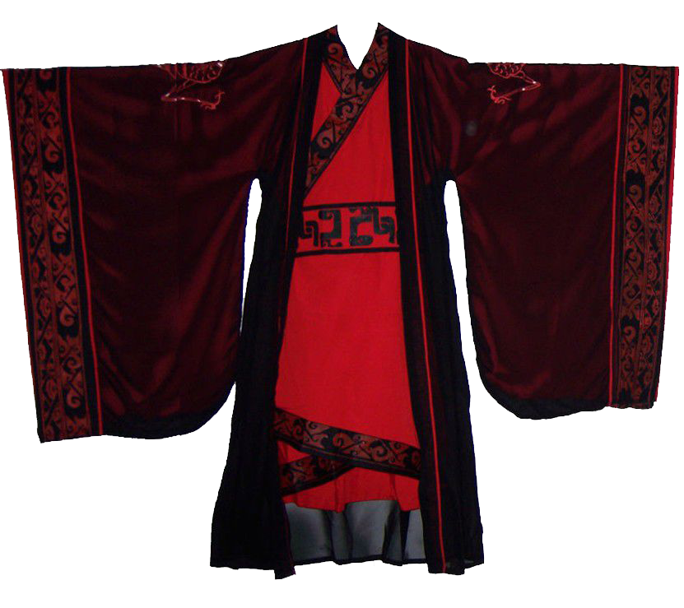

the rich cultural heritage of China,
a garment that has captured the hearts of many:
importance
with its intricate designs and deep-rooted history,
not just a piece of clothing, but a symbol of China's profound cultural identity.

Slide 5
First
origins and significance of Hanfu,

Slide 6
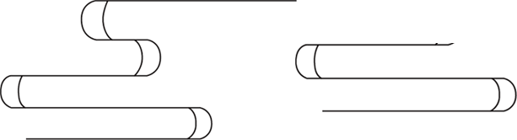
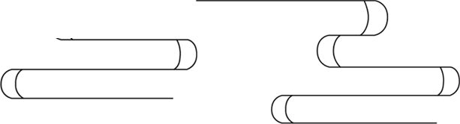
originating from the Han Dynasty,
hanfu
is a traditional Chinese clothing style that has
evolved over thousands of years.

Slide 7
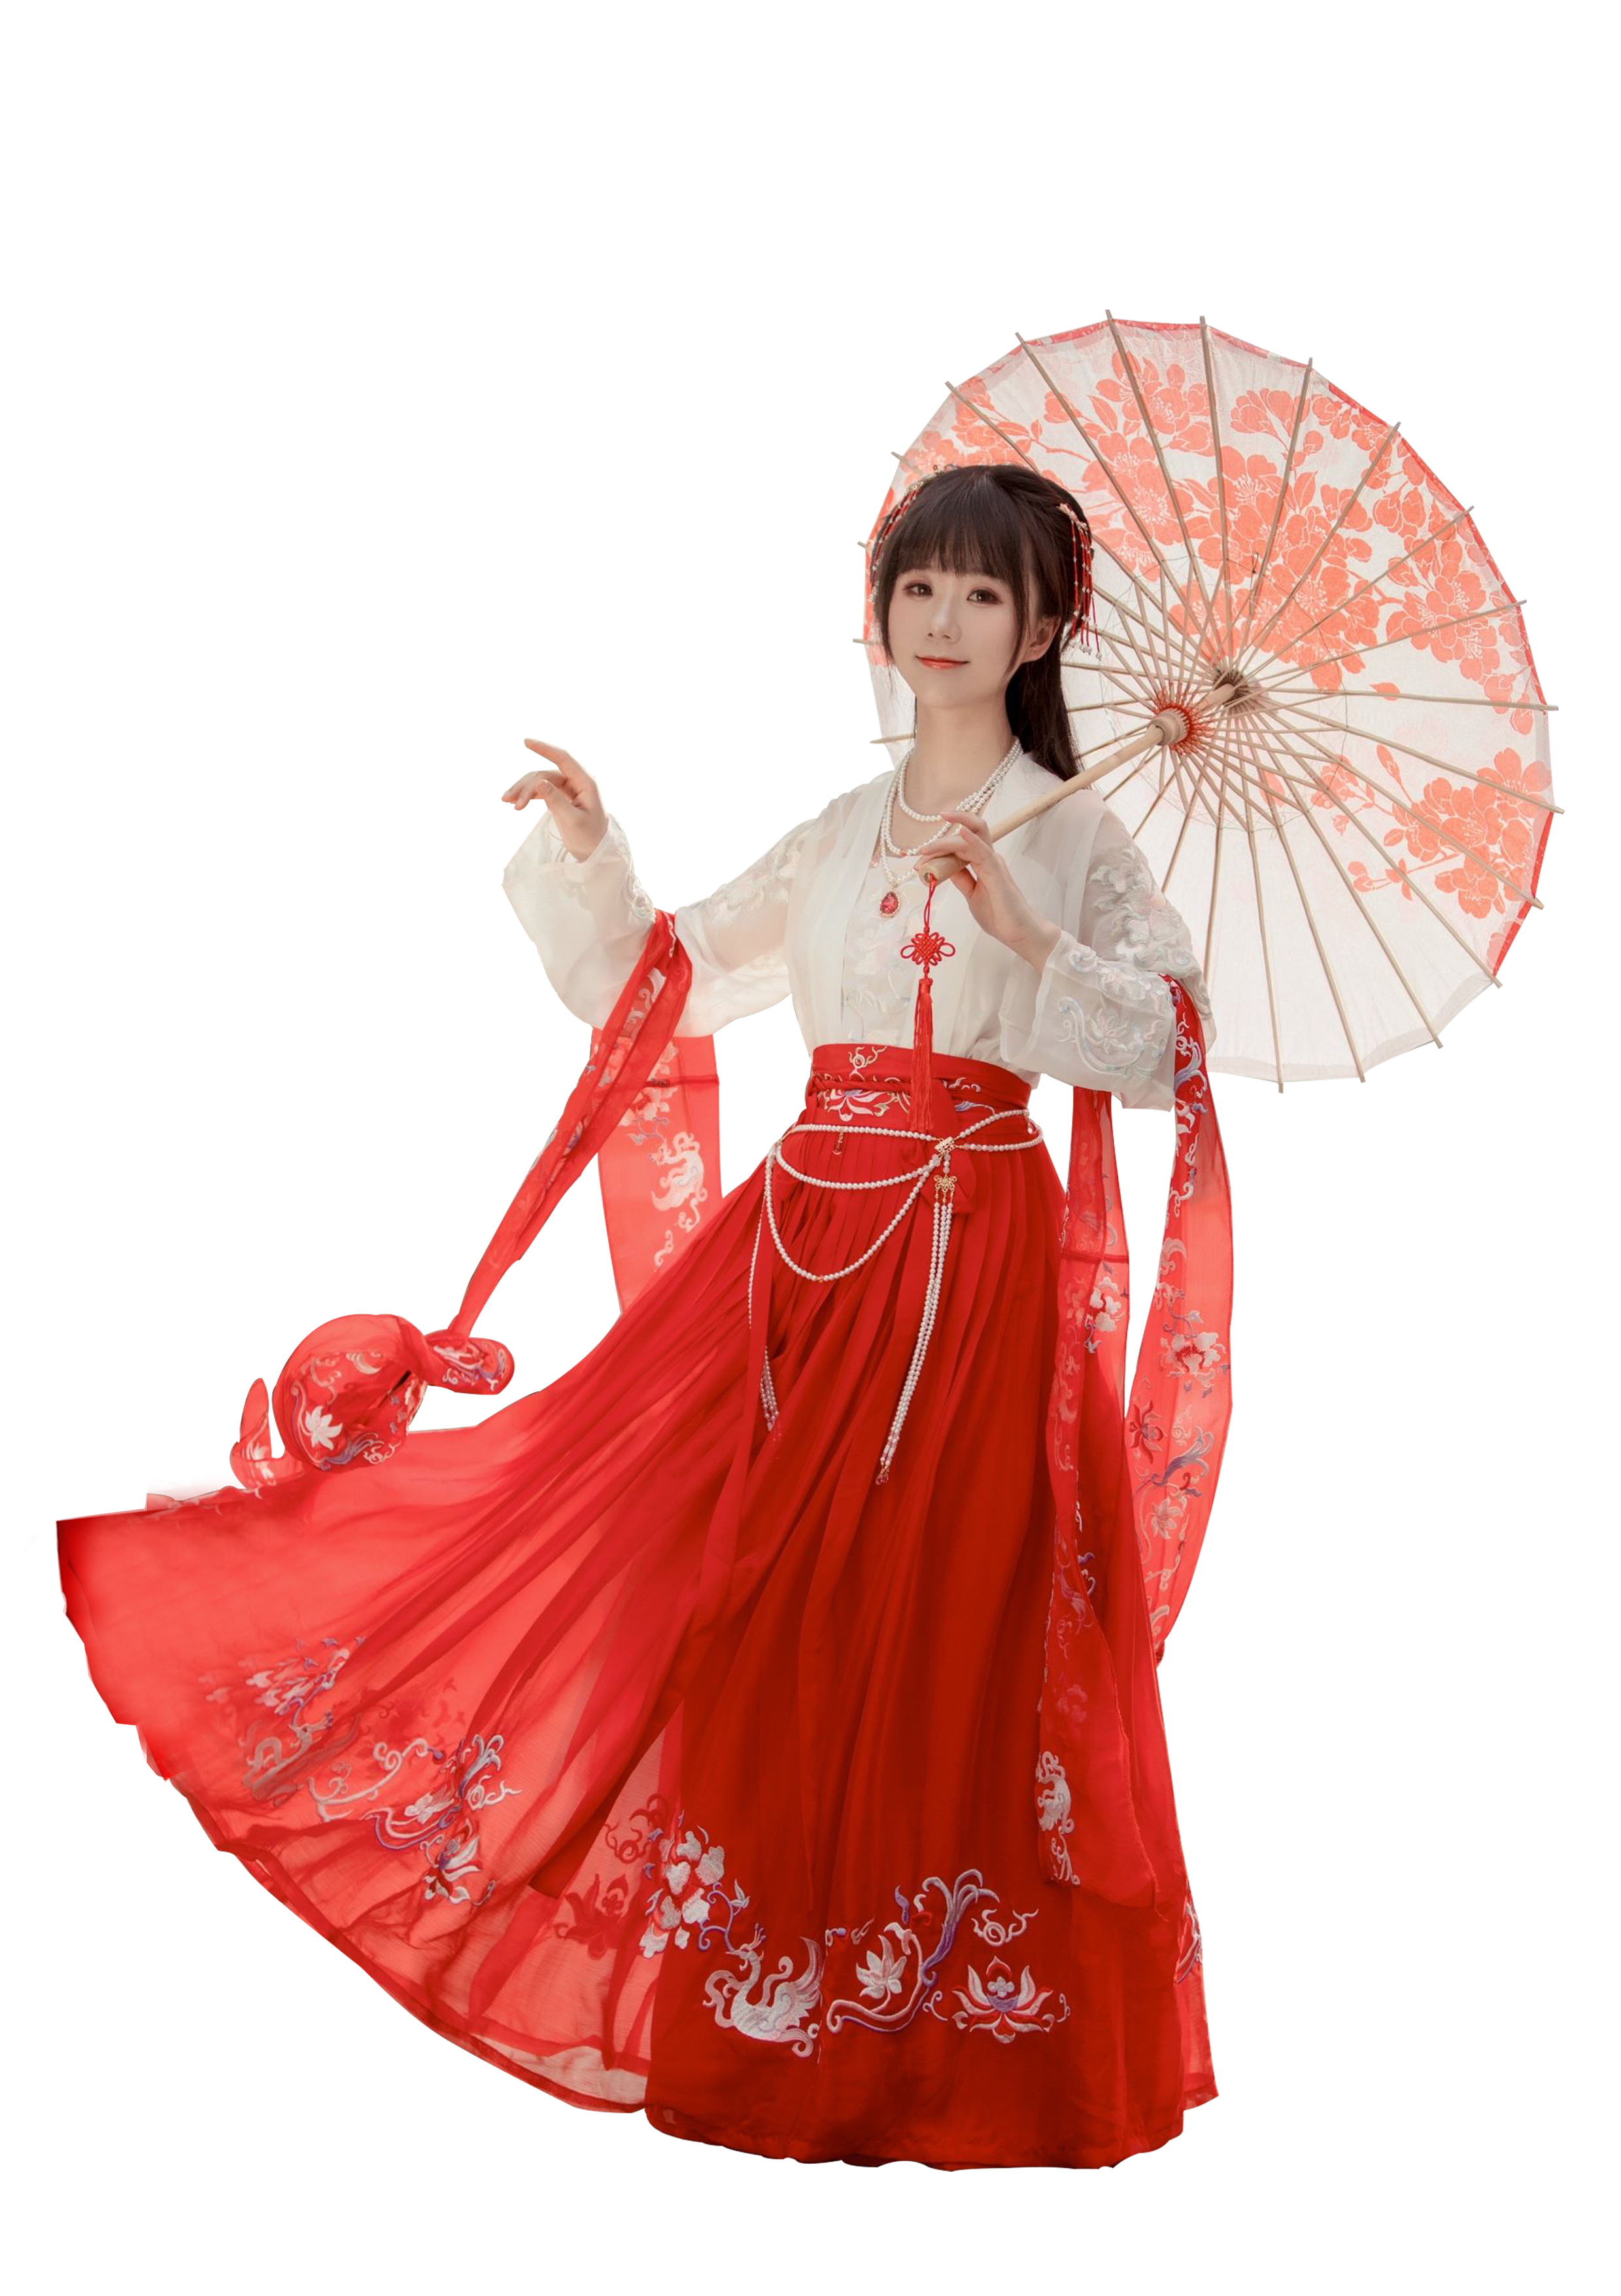
not only showcase the skill of ancient craftsmen
but also tell stories of history and culture.

Slide 8
second
the recent revival of Hanfu.

Slide 9
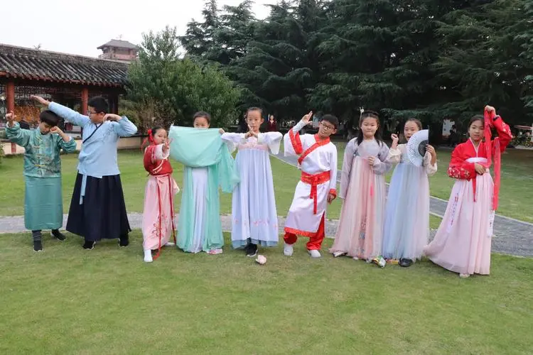
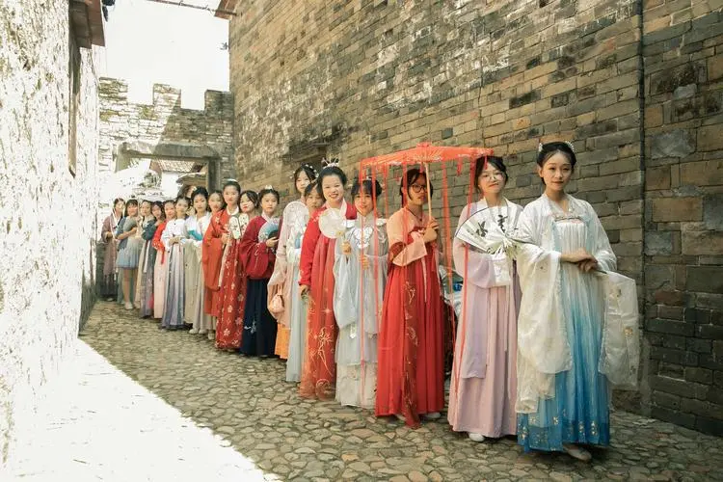
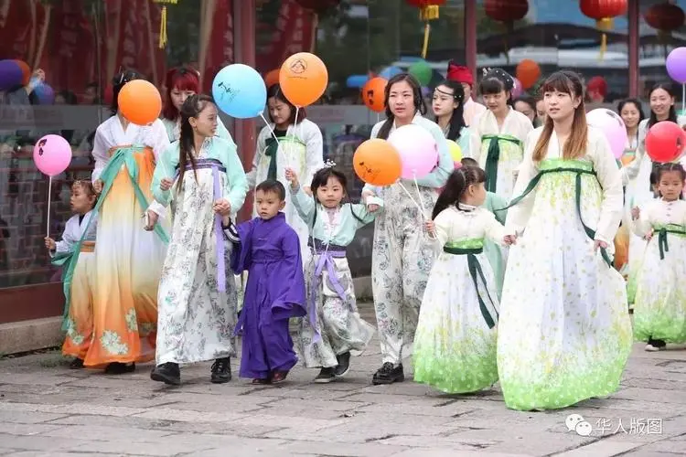
In recent years, there has been a growing interest in Hanfu among young people in China.
关雎
关雎

Slide 10
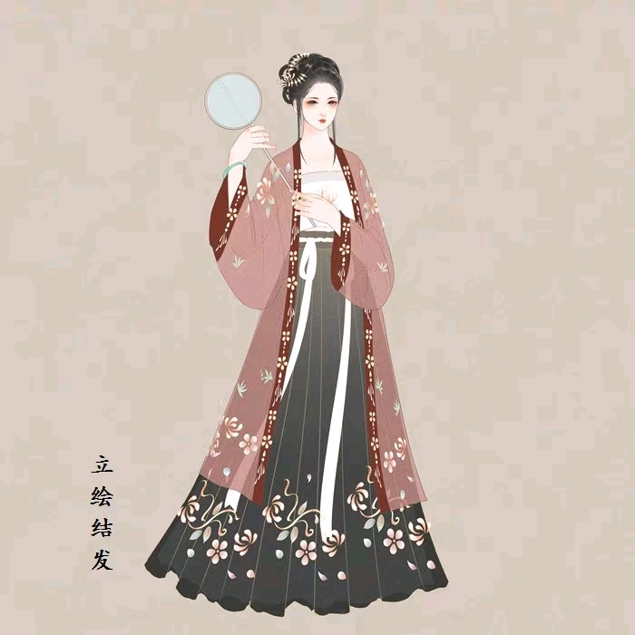
WHY?
This revival is not just a fashion trend but a deeper cultural movement.
People are wearing Hanfu to weddings, festivals, and even daily life, rediscovering its beauty and the pride it brings in their cultural heritage.
This revival is also a testament to the enduring appeal of traditional Chinese culture in the modern world.

Slide 11
third
Challenges of Hanfu,

Slide 12
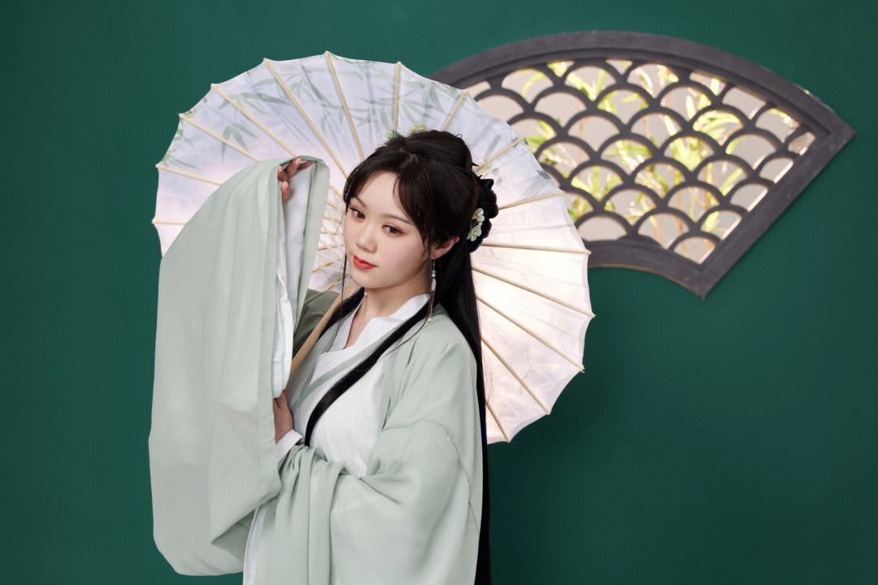

“challenges.”
modern versions may not fully capture the essence of the original.
this revival has sparked a renewed interest in traditional Chinese culture, leading to more research and appreciation for its rich heritage

Slide 13
IN
CONCLUSION

Slide 14
a powerful reminder of the enduring value of traditional culture in the modern world
关雎
a garment; it is a bridge to the past, a window to China's cultural soul
关雎
cherish and celebrate our rich cultural heritage
关雎
IN
CONCLUSION

Slide 15
Thanks

